Slide 1
ELECTRONIC HOSPITAL MANAGEMENT SYSTEM (EHMS)
Group 8
Naveen Kumar Ragam
Abhay Arora
Sai Meghana Gushidi
Jai Srinadh Kalluri
Prathyusha Yanala
Swathi Surikanti
Subramanyam Prasad Sonti
PRESENTATION

Slide 2
Project Description
01
Brief description of the Electronic Hospital Management System
ER Diagram
02
Entity Relationship Diagram for Electronic Hospital Management system
Tech Stack
03
Tools and Technologies used for the Project
ER Mapping
04
AGENDA
Entity Relationship Mapping
Home Page
05
Electronic Hospital Management System Website

Slide 3
Project Description
01
The electronic Hospital Management system is an organized computerized application that is developed and configured to handle day-to-day hospital operations and management. This system comprises patient registration, managing Hospital staff and maintaining their data in the system, and automated billing in the pharmacy and labs for tests assigned by doctors to them.
The system may assign each patient a unique identifier and automatically save the patient's and staff's (Doctor, Nurse, Lab Technician, Accountant) information. A username and password are required to access the Hospital Management System and an administrator has access to modify those data in the Hospital database. Patients can log in and make an appointment with the Doctor choosing the appropriate specialty of the Doctor for their treatment.
.

Slide 4
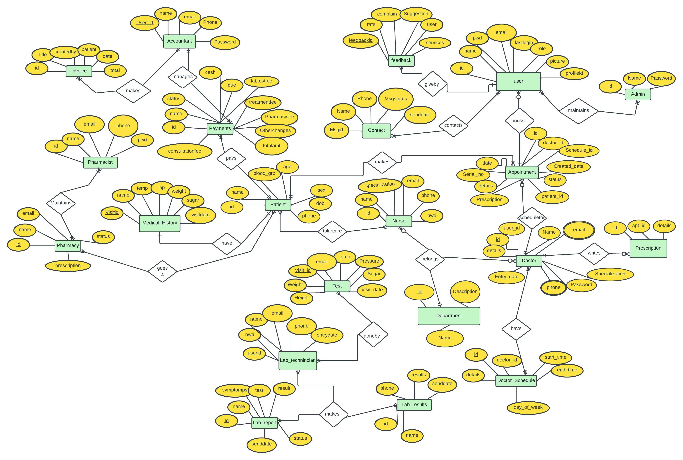
ER Diagram
02
Replace with your own text

Slide 5
03
Tech Stack
Tools and Technologies used
Technologies & Frameworks:
PHP, HTML, CSS, AJAX, BOOTSTRAP, MySQL and JavaScript
Tools & Utilities:
Visual Studio Code and XAMPP

Slide 6
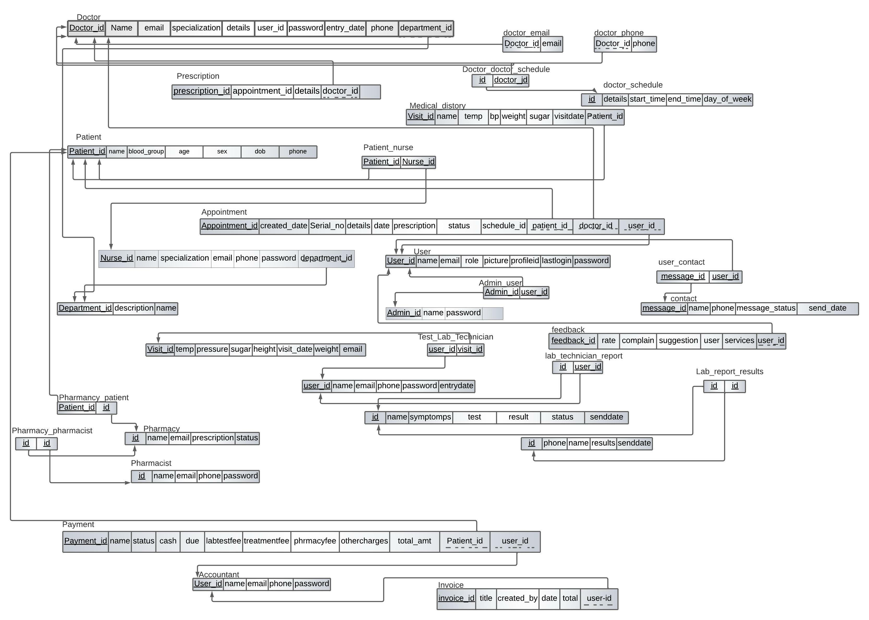
ER Mapping
04
Replace with your own text

Slide 7

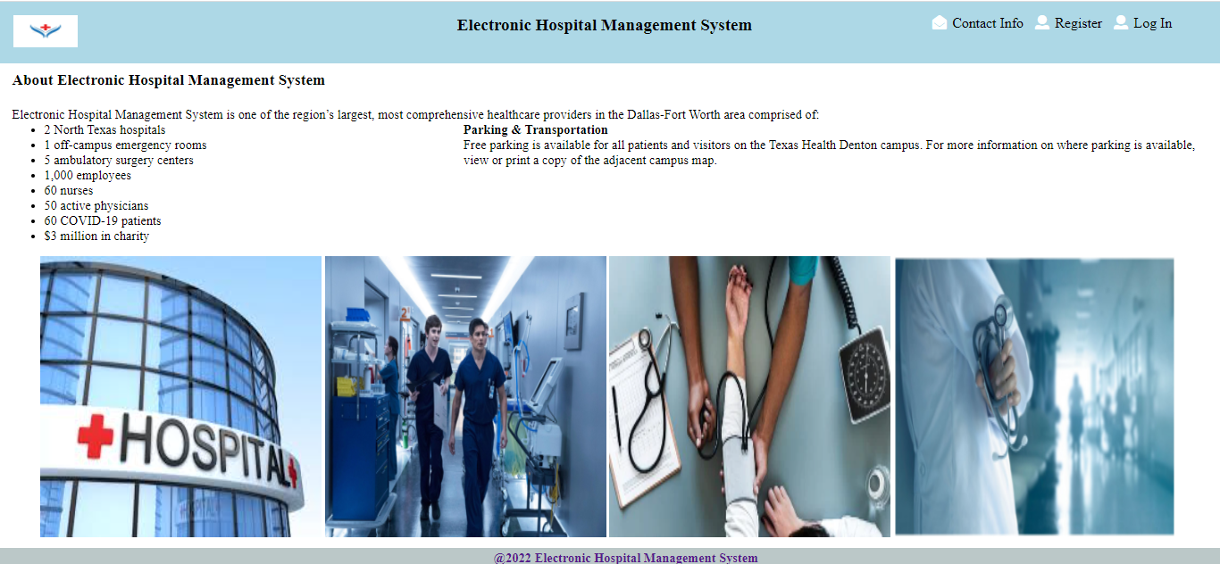
Electronic Hospital Management System Screens
Home Page
About Us Page

Slide 8
DEMO

Slide 9
THANK YOU

